Slide 1
Scratch NeoPixel Programming
Leaning to write programs of your own
Notes:
Previously, you’ve coded the NeoPixels by modifying code that’s been provided to you. You’ll do more of that today, but by the end of the session you will write a simple program from scratch.

Slide 2
Glow.py

Slide 3
Running Glow.py
Open the Terminal Window and type the following commands:
$ cd ~/NeoPixel
$ sudo python3 Glow.py
Notes:
Question: What does this program do?

Slide 4
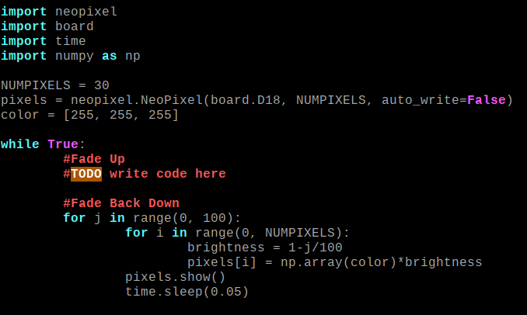
Understanding Glow.py
$ nano Glow.py
Notes:
The top of this program is very similar to Solid.py
This program includes as new import, to bring in the numpy library; which offers a huge range of math functions.
Question: What color do we define here? The program goes into an infinite loop This program includes some comments.
These are notes for the programmer, which are ignored by the computer. The first comment incidates that this is the section of the code that should fade the LEDs up. The second comment, a TODO comment, indicates that this code hasn’t been written yet. The last comment indicates that this is the section of the code that fades the LEDs down.
In this section, the program loops from 0 to 100
Each time, it updates the value of the variable brightness. Each time, it multiples every elements in the array by the value of brightness. This could be done with a loop, but we do it faster and more cleanly with numpy. Question: What is the value of brightness when J equals 0? Question: What is this value of brightness when J equals 100? Finally, the program immediately loops back around to 0 and the process repeats.

Slide 5
Modifying Glow.py
Write Code in the specified location to make the LED array fade up from 0% to 100% intensity before it fades back down again.
Ctrl+x, Ctrl+y, enter to save file
$ sudo python3 Glow.py
Notes:
in this exercise you are expected to write multiple lines of code, instead of just modifying a single line. Hint: Copy/pasting is your friend in this challenge.

Slide 6
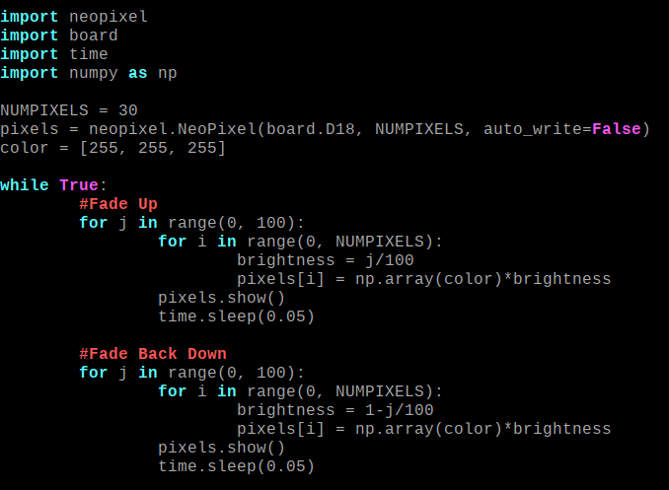
Solution Glow.py
Notes:
The first step should be to just copy everything from the fade down section. This already does 90% of what we need it to, and we only need to make small changes to this functionality to achieve our goal. But we’re going to change something about the way brightness is defined to make it fade up instead of fade down.

Slide 7
Custom.py
Notes:
In this example, you are going to write a program from scratch. Feel free to look at the existing programs as references.

Slide 8
Design Requirements
$ nano Custom.py
Ctrl+x, y, enter to save file
$ sudo python3 Custom.py
Using your knowledge from all the previous examples. Write a program from scratch that does the following:
Defines a collection of color values
Loops over those values, and for each color it sends a pulse of that color from one end of the strip to another.
Loops forever
Notes:
Question: which programs that you’ve worked on so far sound like they might be relevant references for this custom program and why? Give Students 30 mins to work.

Slide 9

Solution Custom.py
Notes:
Lets go over one possible solution to the challenge, keep in mind your program can be very different without being wrong. First we do imports we’ve done in every program We define NUMPIXELS and pixels like we always do. We create an array of color values like we did in Change.py You may have selected entirely different colors, and that’s completely arbitrary. We enter into an infinite loop We loop over the values in colors For each color in colors, we loop over the range of pixels in the neopixel array animate the chase effect from one side of the other. For each frame of the animation, we loop over the range of pixels, to make all the pixels black except the currently displayed one. We wait for 0.01 second between each frame of the animation. Note the indenting here to demonstrate which loop the sleep statement is inside.

Slide 10
End Scratch NeoPixel Programming

